Slide 1


A.O.K. Laptop Overhaul System
Course Project for: IS 436 Structured Systems Analysis and Design
Presented By:
Nima Roomi, Upen Adhikari, Omar Al-Hedari, Alex Varghese
Notes:
Deliverable 1 – “System Request” (D1)
10/03/2019

Slide 2

Team Introductions

Slide 3
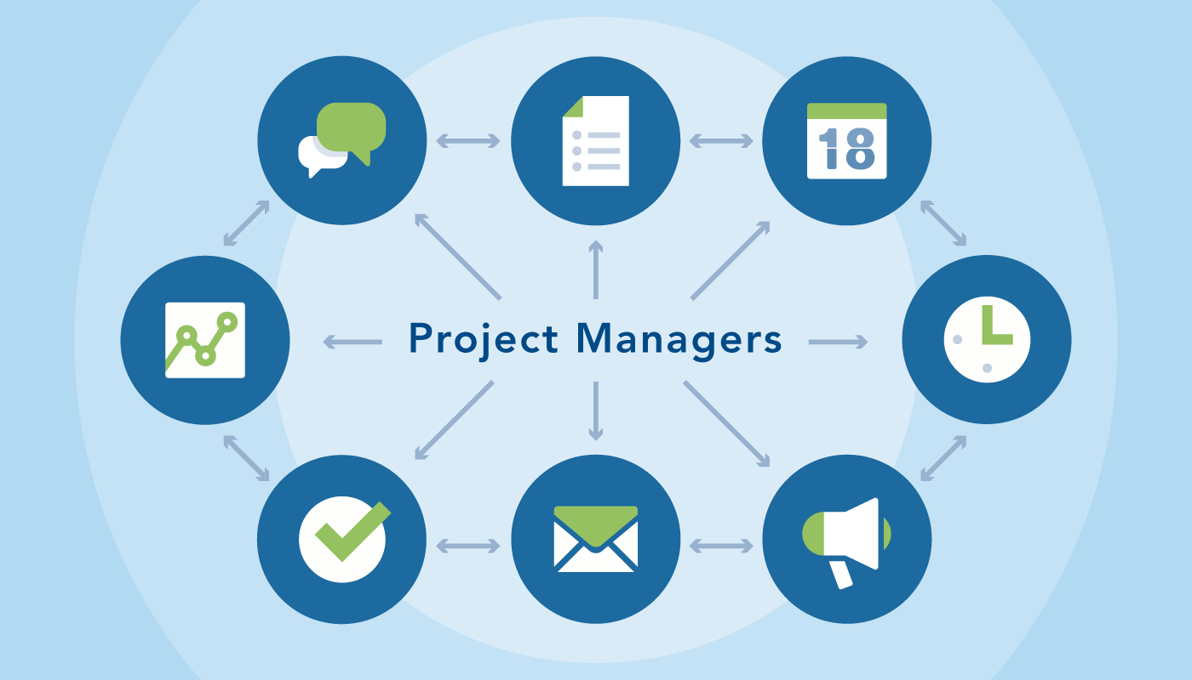
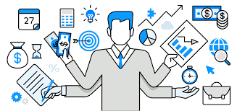
Omar Al-Hedari
Project Manager
Successfully lead on implementation
Meeting timelines and budget requirements.
Coordinates and prioritizes project tasks, manages timelines, maintains project plans
Communicates status to project sponsor

Slide 4
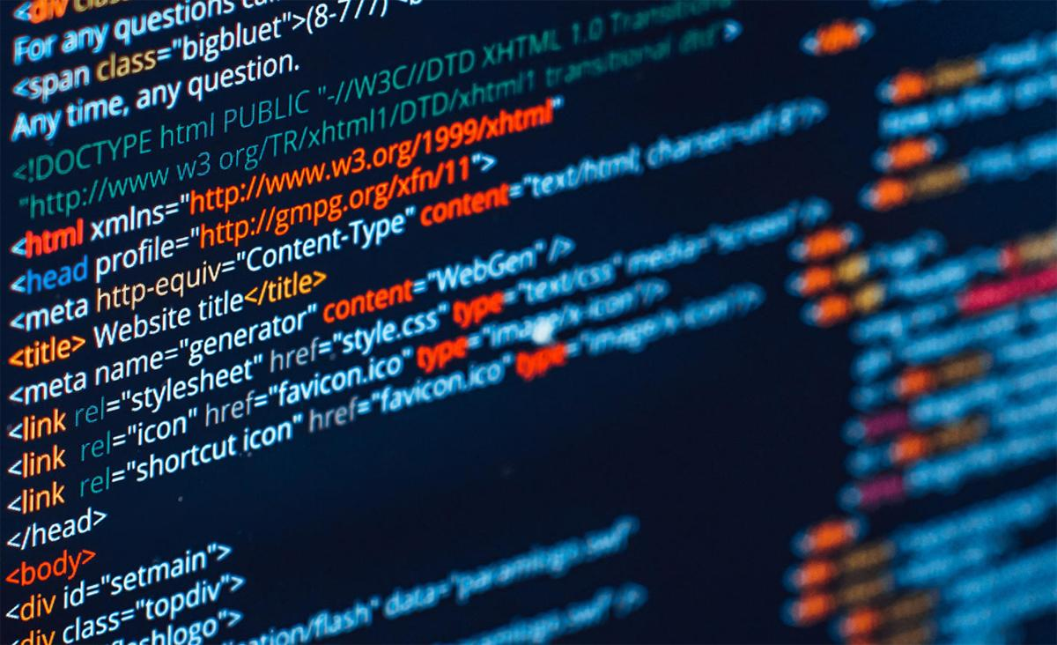
Nima Roomi
Lead Developer/Programmer
Responsible for the underlying architecture of software
Serve as an interface between the programmers and management
Supervise and delegate software and programing tasks

Slide 5
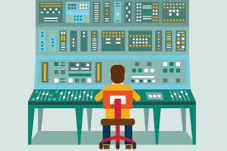
Alex Varghese
Database Administrator
Responsible for the architecture of the database to store and organize necessary information
In charge of capacity planning of the proposed system
Also responsible software installation of the database and monitoring database performance

Slide 6

Upen Adhikari
Quality Assurance
Investigate users complaints and non-conformance issues.
Monitor risk management activities
Develop, recommend and monitor corrective and preventive actions

Slide 7

Existing System
Introduction of laptop loan program in 2015
Three major revisions conducted on the system since then
Primarily manual check in and check out
Policies and program lack clarity
Lackluster website with outdated user design principles
Flawed and unreliable inventory management and tracking

Slide 8

Live Demo
http://lib.guides.umbc.edu/c.php?g=961173
https://library.umbc.edu/

Slide 9

System Request - Purpose
Improve checkout and checkin efficiency
Implement reliable program/system for inventory tracking and management
Reduce patron errors and confusion
Reduce employee workload significantly with automation
Increase laptop loan and retention times
Raise patron accountability to reduce laptop repair and maintenance costs

Slide 10

Project Sponsor
Paula Langley - Library Services Manager
Briefed team with existing circulation systems
Established communications with relevant personnel
Approved system request
Will provide our team with appropriate resources
Provided financial data and designated the overall budget

Slide 11
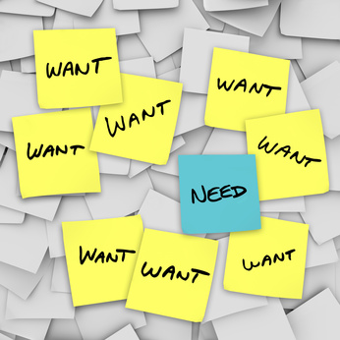
Business Needs
Speeds up the checkout process, resulting in wait time periods during rush hours of operation to be minimized
Online queue-dequeue, push notifications for more natural varying checkout times
Boost employee morale by having a structured automated tasks
Reducing stress level of employees dealing with confusion to follow library procedures to lend laptops
Need of tracking to increase patrons liability on possible damages occurring when they check out the laptop

Slide 12
Business Need Cont.
Reduce angry patrons along with reducing frequently asked questions in regards to the loaning laptop process.
Decrease the repair frequency cost to make efficient use of resources to be lended out to patrons
Mandatory photo attachment feature of the new system in reducing damage repair costs along with the maintenance cost.
Provide detailed information about the lending process assisting in the proper logging, queueing, and the loaning support.

Slide 13
Business Requirement
Small budget for changes to be taken care of to reduce long term costs of implementation
Solution needs to be economical and appropriate to implement
The new system must integrated into legacy systems, ALEPH, to ensure compatibility.
New systems must have minimal costs with respect to hardware along with being easy to manage.
Hardware must be approved by Sheffield, Carolyn Associate Director, Library Technology & Digital Strategies to ensure proper resource allocation and training.

Slide 14

Feasibility Analysis Part 1
Technical Feasibility
There are some risks that occur when implementing this system, such as user familiarity with the technology. For example, because ALEPH does not store pictures, we would have to implement an additional system to be able to store the pictures of laptops to check for damages.
The change can cause confusion with the library employees, but we can fix this issue by requiring a seminar for all employees to familiarize the workers with the new system.
Project size: The development team for the app will consist of 2 freelancers, the mobile app will take 6 months to develop, and the new system will be compatible with ALEPH.

Slide 15

Feasibility Analysis Part 2
Economic Feasibility
Economically feasible due to no need of profit from the library to lend laptops to patrons.
Loaning laptops to UMBC students is a student service that helps students who don’t have one
Reduces the necessary work of the administrative and technical staff while will reduce operational costs.
Ability to track damages of laptops with pictures to make the right decision on whom to charge for it.
Cut down some of the miscellaneous expenses such as printing cost, paper, and the storing cost for paper file storage and documents.

Slide 16
Feasibility Analysis Part 3
Economic Feasibility
Intangible elements
Provide effective and efficient customer service by avoiding operational inefficiencies.
Boost employee morale leading up to an increase of goodwill of the library.
Environmentally friendly due to less consumption of paper.

Slide 17

Feasibility Analysis Part 4
Organizational Feasibility
Address existing issues of the UMBC Laptop loaning problem
System will reduce workload and any inconvenience for both the department and its patron.
Library has enough space to accommodate hardware devices so the implementation of the system would not affect any organizational structure
System can be implemented within existing hardware devices of the library.
User friendly with current library employees

Slide 18
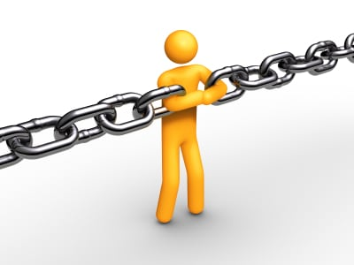
Special Issues or Constraints
Potential scalability and interfacing problems due to integration of online reservation on myUMBC site due to the site being able to be accessed from different departments of UMBC
Limited space for additional hardware
Such as servers

Slide 19
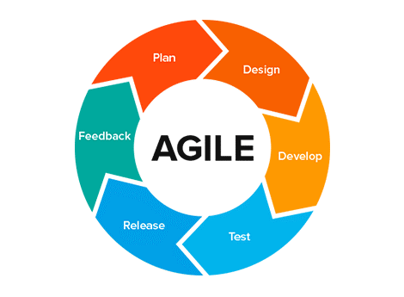
Project Methodology
Design and implement our project using Agile methodology
The methodology will give us the opportunity to work through prototyping to improve every iteration in the development cycle.
Best fit to address specific requirement changes
Flexible with increase of productivity for the team.

Slide 20
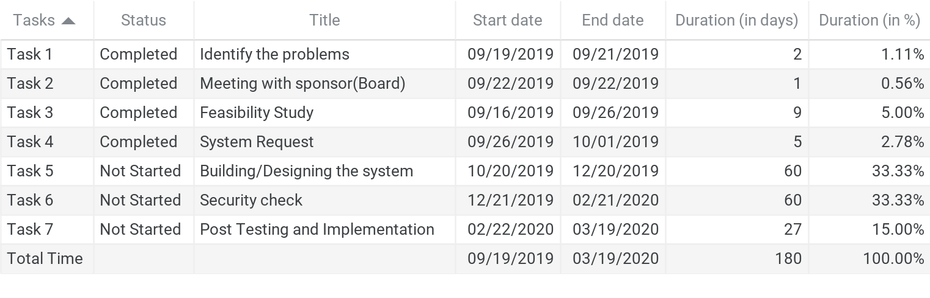
Work Plan

